Slide 1


Objectives
In this session, you will learn to:
JavaScript Arrays
HTML DOM Model
List of events in JavaScript
Validation form using JavaScript

Slide 2
JavaScript Arrays
JavaScript arrays are used to store multiple values in a single variable.
An array is a special variable, which can hold more than one value at a time.
An array can hold many values under a single name, and you can access the values by referring to an index number.

Slide 3



Creating an Array
Using an array literal
Using the JavaScript Keyword new
You refer to an array element by referring to the index number.

Slide 4
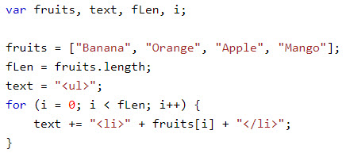
JavaScript Arrays
The length property
Returns the length of an array (the number of array elements).
Looping Array Elements
Using a for loop

Slide 5
Common Array Function
concat()
valueOf()
shift()
unshift(items...: any)
pop()
push(items...: any)
splice(start: int, deleteCount: int, items...: any)

Slide 6
HTML DOM
The HTML DOM (Document Object Model)
With the HTML DOM, JavaScript can access and change all the elements of an HTML document.
When a web page is loaded, the browser creates a Document Object Model of the page.
The DOM is a W3C (World Wide Web Consortium) standard.
The DOM defines a standard for accessing documents:
"The W3C Document Object Model (DOM) is a platform and language-neutral interface that allows programs and scripts to dynamically access and update the content, structure, and style of a document."

Slide 7
What is the HTML DOM?
The HTML DOM is a standard object model and programming interface for HTML. It defines:
The HTML elements as objects
The properties of all HTML elements
The methods to access all HTML elements
The events for all HTML elements
In other words: The HTML DOM is a standard for how to get, change, add, or delete HTML elements.

Slide 8
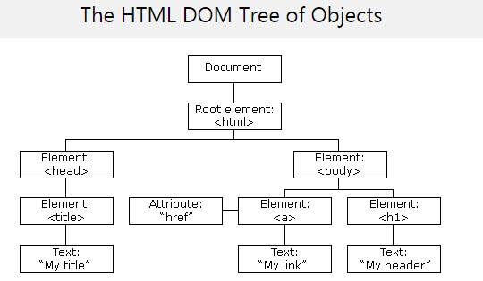
HTML DOM Model
The HTML DOM model is constructed as a tree of Objects:

Slide 9
HTML DOM Methods
The DOM Programming Interface
The HTML DOM can be accessed with JavaScript (and with other programming languages).
In the DOM, all HTML elements are defined as objects.
The programming interface is the properties and methods of each object.
A property is a value that you can get or set (like changing the content of an HTML element).
A method is an action you can do (like add or deleting an HTML element).
getElementById() Method
Access an HTML element is to use the id of the element
innerHTML Property
Useful for getting or replacing the content of HTML elements.

Slide 10
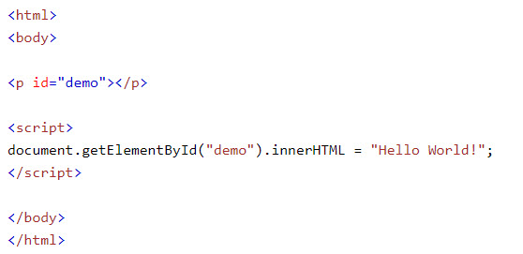
Demo
Example:

Slide 11

JavaScript HTML DOM - Changing CSS
The HTML DOM allows you to execute code when an event occurs.
Events are generated by the browser when "things happen" to HTML elements:
An element is clicked on
The page has loaded
Input fields are changed
To change the style of an HTML element, use this syntax:

Slide 12
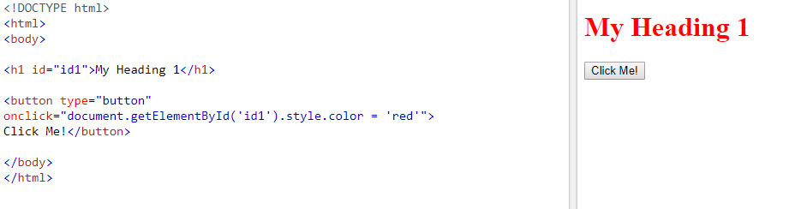
Demo
Example:

Slide 13
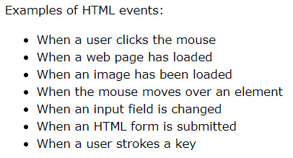
Reacting to Events
A JavaScript can be executed when an event occurs, like when a user clicks on an HTML element.
To execute code when a user clicks on an element, add JavaScript code to an HTML event attribute:
Example: onclick=JavaScript

Slide 14
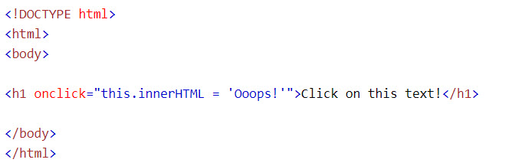
Demo

Slide 15
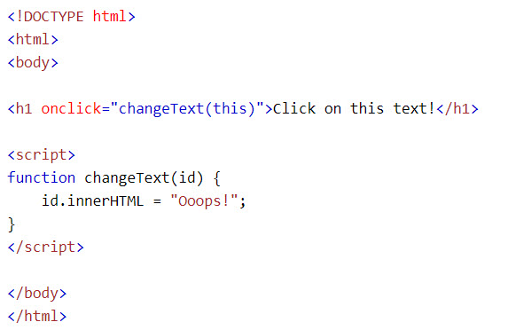
JS Events
We can associate an event with an event handler

Slide 16
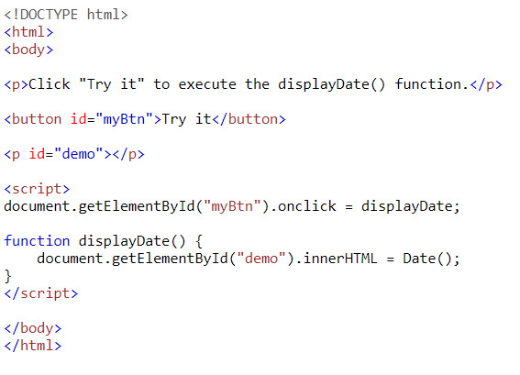
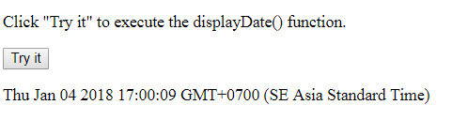
Assign Events Using the HTML DOM
The HTML DOM allows you to assign events to HTML elements using JavaScript:
Output:

Slide 17
List of events
The onload and onunload events are triggered when the user enters or leaves the page.
The onchange event is often used in combination with validation of input fields.
The onmouseover and onmouseout events can be used to trigger a function when the user mouses over, or out of, an HTML element.
The onfocus event: is triggered when user put focus into a control.
The onblur event: is triggered when user leave from a control.

Slide 18
List of events
The onresize event: is triggered when user resize a web page.
The onsubmit event: is triggered when user submit form.
The onmousedown, onmouseup, and onclick events are all parts of a mouse-click.
First when a mouse-button is clicked, the onmousedown event is triggered,
then, when the mouse-button is released, the onmouseup event is triggered,
finally, when the mouse-click is completed, the onclick event is triggered.

Slide 19
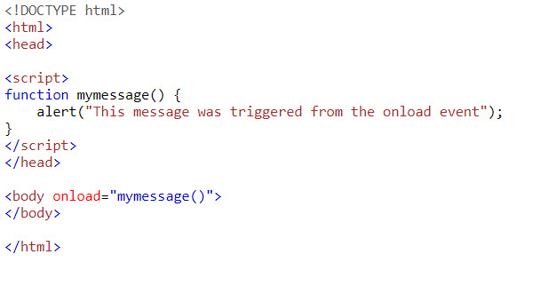
JS Events
Example of onload event:

Slide 20
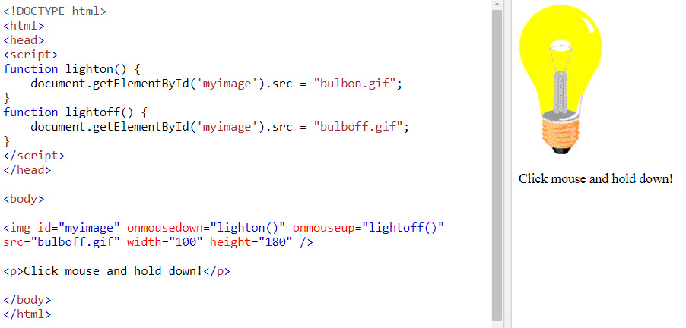
JS Events
Example of mouse events:

Slide 21
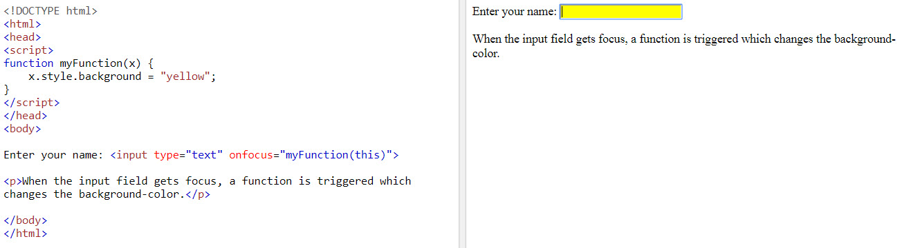
JS Events
Example of onfocus events:

Slide 22
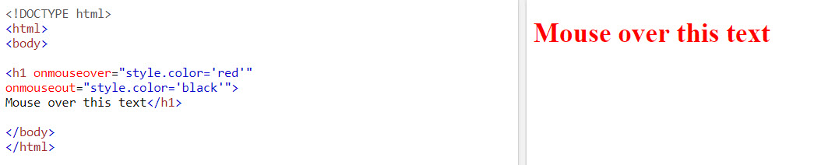
JS Events
Example of onmouseover/onmouseout events:

Slide 23
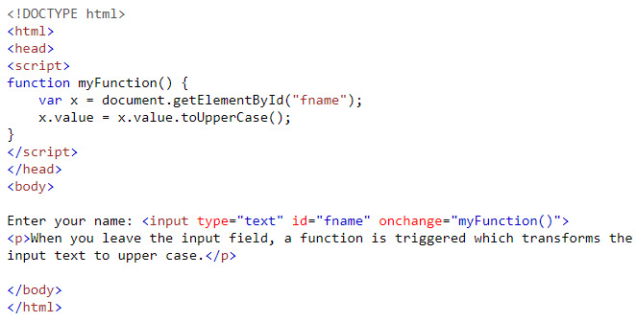

JS Events
Example of onchange event:
Code:
Output:

Slide 24
Data Validation
Data validation is the process of ensuring that user input is clean, correct, and useful.
Typical validation tasks are:
has the user filled in all required fields?
has the user entered a valid date?
has the user entered text in a numeric field?
Most often, the purpose of data validation is to ensure correct user input.
Validation can be defined by many different methods, and deployed in many different ways.
Server side validation is performed by a web server, after input has been sent to the server.
Client side validation is performed by a web browser, before input is sent to a web server.

Slide 25
Demo
Demo validate HTML form using JavaScript

Slide 26
Summary
In this session, you learned that:
JavaScript Arrays
HTML DOM Model
List of events in JavaScript
Validation form using JavaScript

